Slide 1
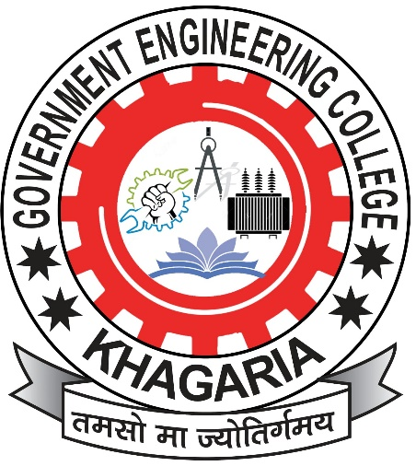
Government Engineering College, Khagaria
(GEC Khagaria)
e-Learning Chemistry
Dr. Amit Kumar Singh
Assistant Professor
GEC Khagaria

Slide 2
CONTENTS
Chapter 3: “Organic reactions and synthesis of a drug molecule”
Chapter Plan
Introduction to intermediates
Reactions involving substitution, addition, elimination
Oxidation- reduction, Diels elder cyclization and epoxide ring openings rxn
Synthesis of a commonly used drug molecule like aspirin.
Introduction to intermediates
Intermediates are organic species which are formed for a short live during the reaction and further final product is formed from that intermediate. As we all know that it is very difficult to isolate intermediates, only few stale intermediates can be isolated.
Types of intermediates.
Carbocation Carbanion Free radical
Dr. Amit K. Singh, GEC Khagaria

Slide 3
Carbocation
Organic Species having 6 electrons paired having positive charge on central carbon.
In Carbocation central carbon is SP² hybridized, Planar (means every atoms on the single page) with a vacant p-orbital, which will be perpendicular to the plane (means above at 90º to the page)
There are two types of carbocation:
Short lived: C⁺ (CH₃)₃C⁺, (CH₃)₂CH⁺
Stable C⁺: (Ph)₃C⁺, (Ph)₂CH⁺
Formation of C⁺ by Heterolytic cleavage:
By direct breaking of C-X bond in presence of highly polar solvent
Dr. Amit K. Singh, GEC Khagaria

Slide 4
ii) By adding of proton to unsaturated comp.
Stability Order:
Normal stability order of carbocation.
Over all stability order of carbocation
Here Carbocation stability order is due resonance as the positive charge is delocalized on various carbon atoms, whereas CH₃⁺ is least stable, as in this case the positive charge is not delocalized. It is fully present on a single carbon atom.
Dr. Amit K. Singh, GEC Khagaria

Slide 5
Carbanion
Organic species with negative charge on the central carbon atom having one pair of electron present in the SP³ orbital. In carbanion there is 3 covalent bonds present.
It is formed by different ways
i) Formation of C⁻ by Heterolytic cleavage of C-H bond.
ii) By breaking of C-M (M= Metal) bond.
Dr. Amit K. Singh, GEC Khagaria
ii) By breaking of C-M (M= Metal) bond.

Slide 6
Stability Order of Carbanion
3º is least stable as there are three methyl group which donate electron to the central carbanion so on that carbon negative charge is more compared to other, making it least stable. As more charge less stable.
Dr. Amit K. Singh, GEC Khagaria

Slide 7
Free radical
A species having a C-atom with one free electron and no charge is called as free radical.
Structure: Free radicals are generally SP² hybridized
Stability:
Dr. Amit K. Singh, GEC Khagaria

Slide 8
2nd Lecture will be on “Reactions involving substitution, addition, elimination.”
Dr. Amit K. Singh, GEC Khagaria

